Slide 1


Programming with Block Coding: A Creator Tool
Welcome to the world of block coding, a powerful and engaging way to learn programming, explore artificial intelligence, and build robots.
Presented By: Presented To:
NIKHIL RAMTEKE PROF. SAMIKSHA SHUKLA

Slide 2
Contents: -
What is Block Coding ?
Block Coding (no text required, drag & drop)
Drag-and-Drop Programming Interface
Building Blocks for Coding
Benefits of Block Coding
Coding for Beginners and Experts
Creator Tool for Coding, AI, and Robotics
Extensions Tools for Block Coding
Integrating AI and Robotics
Real-World Applications of Block Coding
Conclusion and Next Steps

Slide 3

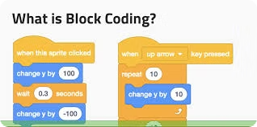
What is Block Coding?
A visual programming language that uses blocks to represent commands and code.
No Text Required
Drag and Drop
Intuitive and accessible for beginners.
Simply drag and drop blocks to create programs.

Slide 4
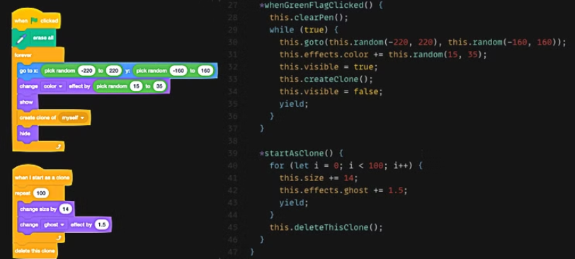
No Text Required
We can directly use coding blocks, no need to write text for it.

Slide 5
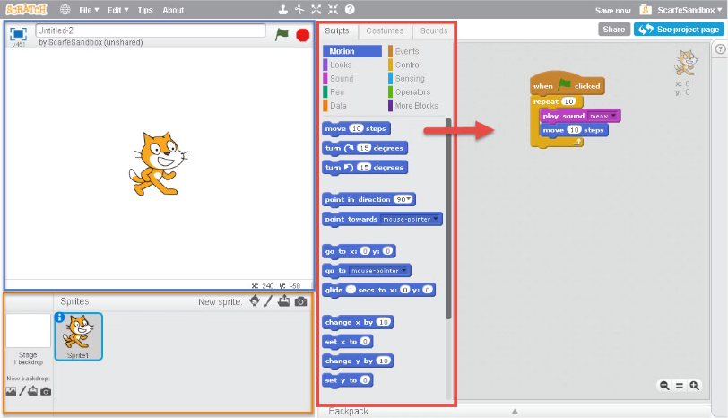
Drag & Drop
We can directly drag the blocks and drop it in the workspace.

Slide 6


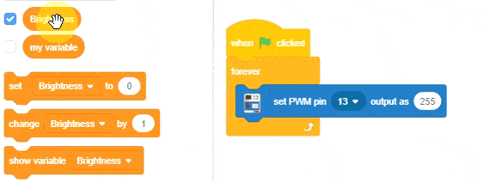


Drag-and-Drop Programming Interface
Simple and user-friendly interface for building code.
Select Block
Choose a block from the palette.
Drag to Workspace
Drag the selected block to the workspace.
Connect Blocks
Snap blocks together to create a program.

Slide 7

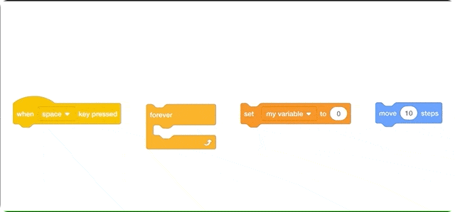
Building Blocks for Coding
Each block represents a specific command, function, or data type.
Motion
Control
Looks
Sound
Events
Data
Operators
Variables
Functions

Slide 8
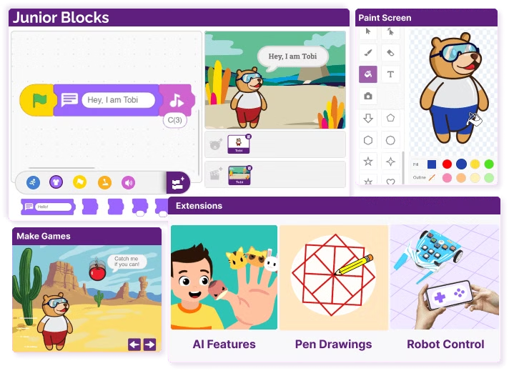
Benefits of Block Coding
Promotes creativity and problem-solving skills.
1
Engaging Learning
2
Visual Approach
Makes learning fun and interactive.
Simplifies complex concepts.
3
Hands-on Experience
4
Accessible to All
Allows immediate experimentation.
No prior coding experience needed.

Slide 9




Coding for Beginners and Experts
Accessible to beginners, yet powerful enough for advanced users.
Learn the Fundamentals
Build a strong foundation in programming.
Explore Advanced Concepts
Dive deeper into more complex topics.
Collaborate and Share
Work together on projects and share creations.

Slide 10
Creator Tool for Coding, AI, and Robotics
Enables users to create interactive projects, AI applications, and robotic systems.
Coding
Artificial Intelligence
Robotics
Develop games, animations, and web applications.
Build simple AI models for tasks like image recognition.
Control and program robots to perform various actions.

Slide 11
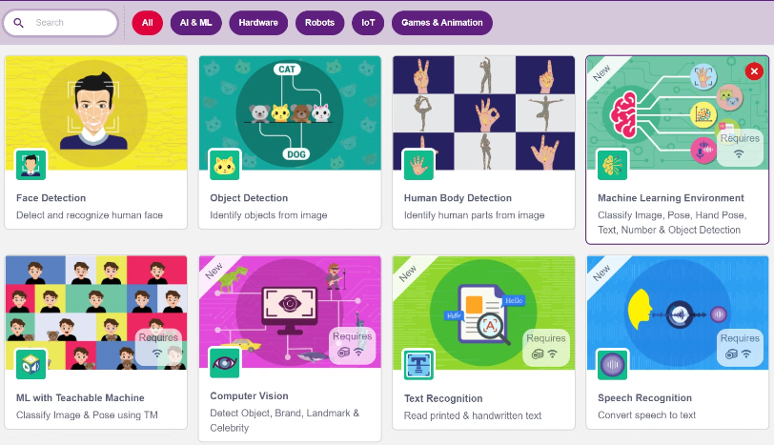
Extensions Tools for Block Coding
We can use various type of extension tools available in respective Block Coding Applications.

Slide 12
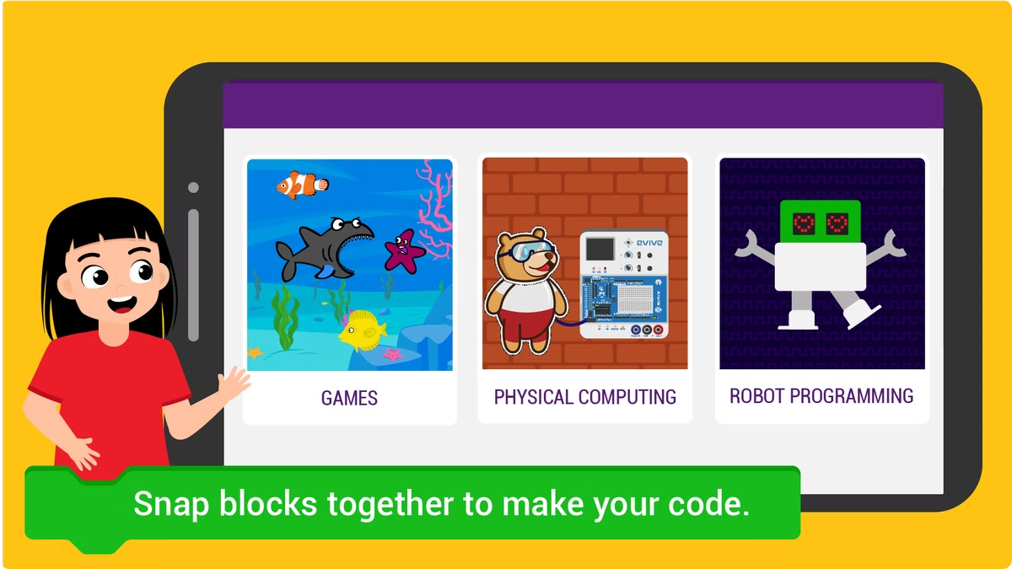
Integrating AI and Robotics
Block coding empowers users to build AI-powered robots and systems.
1
AI Development
Train AI models to perform specific tasks.
2
Robot Control
Program robots to respond to AI decisions.
3
Real-world Applications
Create robots for tasks like automation and assistance.

Slide 13



Real-World Applications of Block Coding
Block coding is used in a wide range of industries.
Education
Robotics
Web Development
Engaging and interactive learning experiences.
Control and program robots for various tasks.
Develop interactive web applications and games.

Slide 14

Conclusion and Next Steps
Block coding offers an engaging and accessible approach to programming.
1
Explore Further
2
Start Creating
3
Share and Learn
Try different block coding platforms like pictoblox, and explore their features.
Begin building your own projects and explore the possibilities.
Join communities like STEMpedia, share your work, and learn from others.

Slide 15


Any Questions..?
Everyone, thank you for your time…

